Slide 1
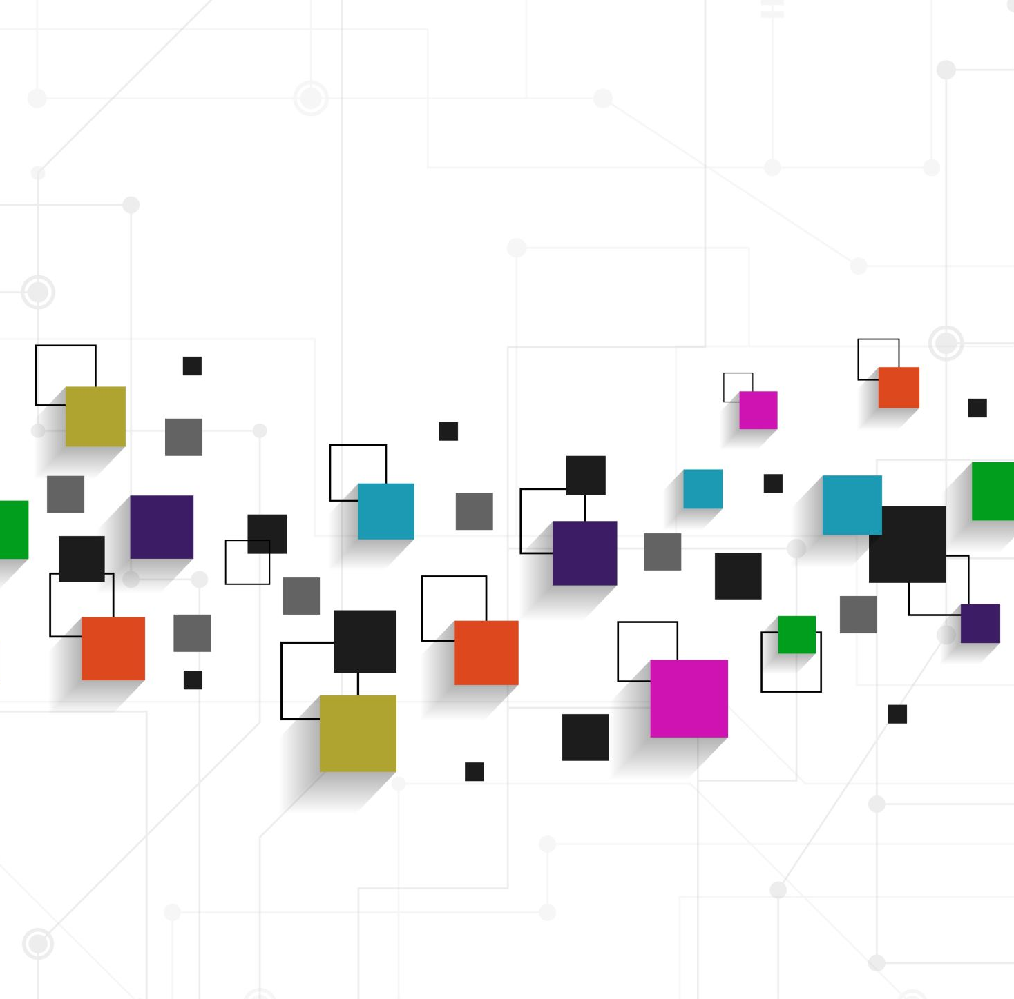
A Scrum-agile team typically consists of three key roles:
Scrum Master: The Scrum Master ensures the team is operating effectively within the Scrum framework. They facilitate daily Scrum meetings, lead sprint planning meetings, conduct retrospective reviews, and manage obstacles that arise for the team.
Product Owner: The Product Owner ensures the Scrum team aligns with the overall product goals. They understand the business needs of the product, like customer expectations and market trends. They manage the product backlog by ordering work by priority.
Development team: A development team is composed of professionals who do the hands-on work of completing the tasks in a Scrum sprint. This means development team members can be computer engineers, designers, writers, data analysts, or any other role needed to reach sprint goals.

Slide 2
Software Development Life Cycle (SDLC) is divided into several phases:
Concept: This is the initial phase where the idea for the software is conceived.
Inception: In this phase, business analysts work with stakeholders to determine and document the software requirements.
Development: This phase involves translating the requirements into a software solution and creating a high-level design. Developers build the software based on the system design. Agile SDLC breaks a larger project down into smaller cycles and/or sprints.
Testing: The software is tested for bugs and defects and to make sure that it meets the requirements.
Deployment: The software is released to the production environment where it is installed on the target systems and made available to users.
Maintenance: This ongoing process includes training and supporting users, enhancing the software, monitoring performance, and fixing any bugs or security issues.

Slide 3
The Waterfall approach compared to Agile approach: - The information would have been gathered at the beginning of the project. Should any changes occur, this would be difficult to incorporate. - The design of the project would occur next. If there was any issues that occur later in development or testing. Changing the design of the project would be costly and time consuming. - During the development phase, if a problem or issue was found while coding this could involve going back to the design phase. - The testing phase can present problems that lead to significant delays, and could require changes to code, design, or even the initial information. - Maintenance occurs after the product or project is deployed. This is when problems are discovered and addressed, but because of the structure of the waterfall method. This can be very challenging.

Slide 4
Choosing between Waterfall approach and Agile approach:
Project size: For smaller projects, an Agile approach can be more suitable because it allows for more flexibility. For large projects with a bit more complexity, the Waterfall approach could provide a better framework.
Requirements: If the requirements are well defined and unlikely to change, the Waterfall approach would be a good choice. If the requirements are more unclear and expect changes, the Agile approach would be a better fit because of its flexibility.
Time: The Waterfall approach tends to have a longer delivery approach, where as the Agile approach can provide a quicker delivery because components of the project are broken down into smaller sprints.
User Involvement: If the project is expected to have active communication and involvement with the user, using an Agile approach would help be more beneficial for the project. This is because a Waterfall approach requires less user involvement beyond the requirements.
Teamwork: If a team is more experienced with collaborations and cross functionalities, using an Agile approach would be more beneficial. If a team is more comfortable with a structured linear approach, using a Waterfall approach would be a better fit.

Slide 5
Resources:
https://resources.github.com/software-development/what-is-sdlc/
https://www.coursera.org/articles/scrum-roles-and-responsibilities#Development%20Team
https://www.float.com/resources/agile-vs-waterfall/
https://www.productplan.com/learn/agile-vs-waterfall/

